Slide 1
Super Bowl LIII Commercials: The Impact on Stock
Joshua Linton
Gunter Pevey
Candice Garcia
Carla Cohen

Slide 2
Questions (we can/should change this header ☺)
One of the attractions of the Super Bowl are the unique commercials aired during the game.
Since, companies invest a large amount of money to come up with unique commercial ideas and secure a spot on the prime time slot, our group decided to analyze the affects of these commercials on the companies’ stock value.
Is there a stock value increase after the Super Bowl?
Is there an impact on volume traded?

Slide 3

Finding the Information
Initially we began the project using two data sets. Alphavantage, a free stock market API; and Yahoo!Finance.
However, because the data sets were different and didn’t quite offer the same information, we ultimately decided to only use Yahoo!Finance.
We found this API using RapidAPI.

Slide 4
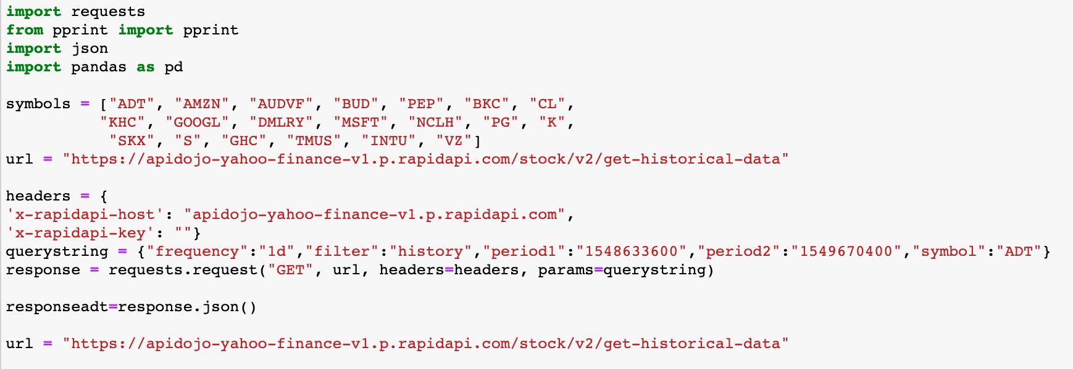
Example of Notebook Calling API

Slide 5
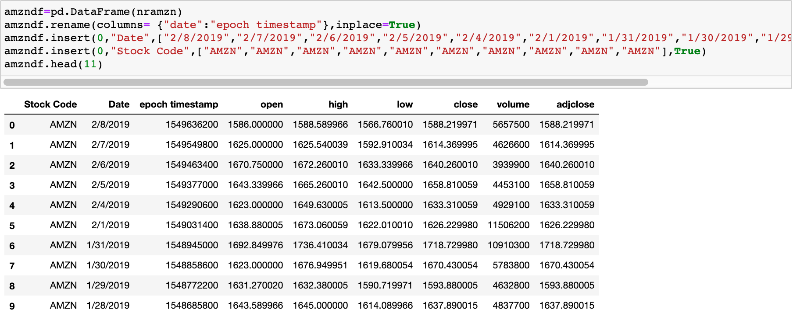
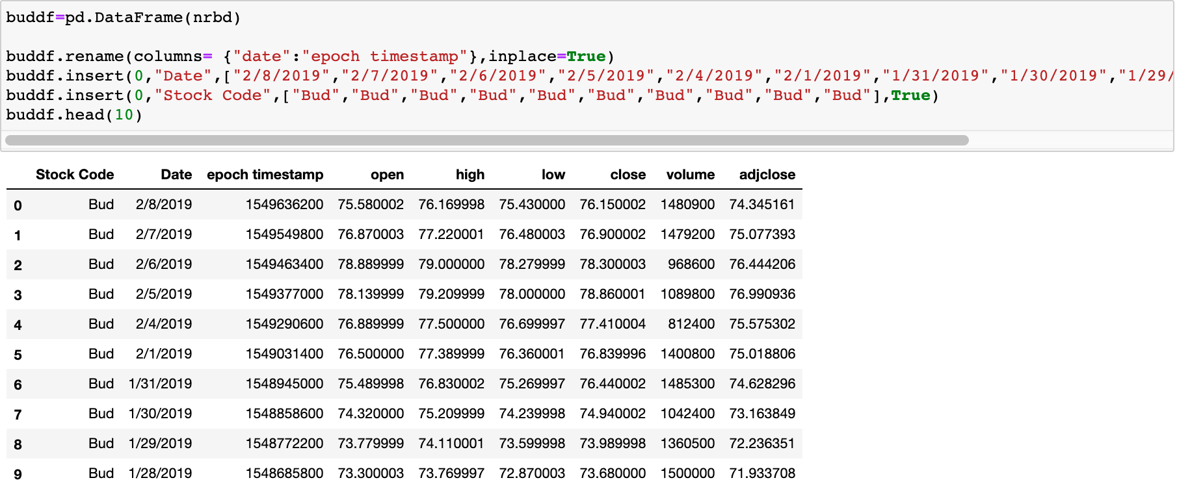
Finding the Code
The process to which we were finally able to get an end result was painstaking to say the least.
Ultimately, Joshua was able to figure out a way to loop each individual company by creating their own dataframes.

Slide 6
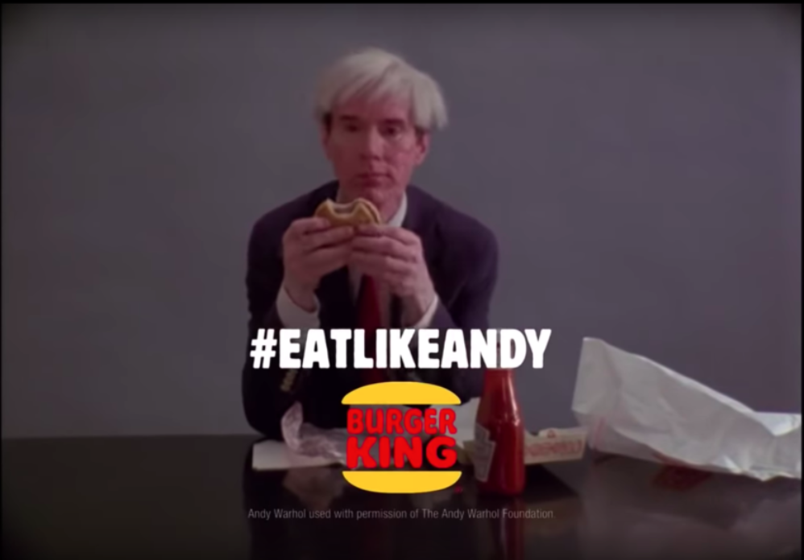
Companies of Study
As you could see from the previous snippet of code, we studied twenty different companies (ADT, Amazon, Budweiser, etc.) that had commercials that aired during Super Bowl LIII.
Burger King’s Super Bowl LIII Commercial
https://youtu.be/4bv9LMxPkqk

Slide 7
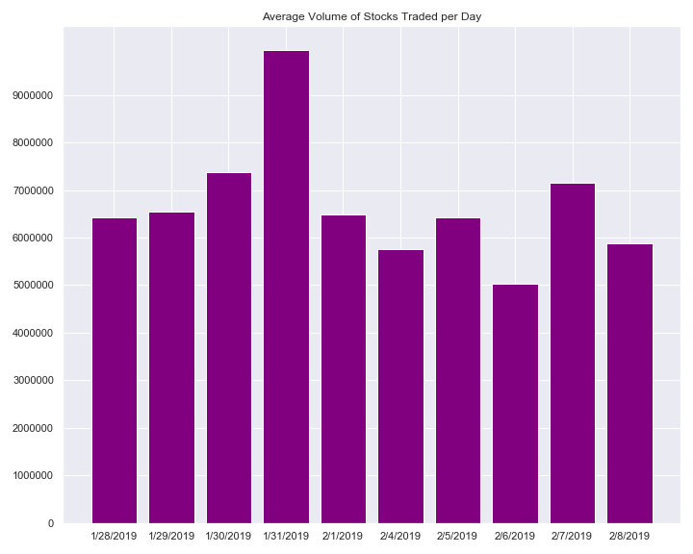
Did the volume of stocks trade increase after the Super Bowl?
As displayed on our Average Volume of Stocks Traded per Day graph, it appears that there was no immediate increase in stocks traded after the Super Bowl commercials aired.
The referenced graph shows historical data on the volume of stocks traded a week before and a week after the Super Bowl weekend by the number of shares.
We speculate that the 01/31/2019 increase was due to month end regular trend.

Slide 8
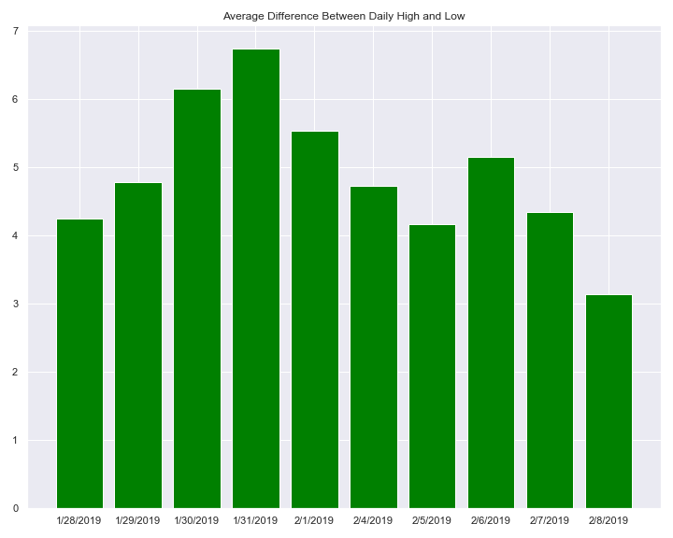
What were changes of trend that typically occurred during the Super Bowl’s timeframe?
Consistently with the previous graph, it does not appear that the Super Bowl commercials had a positive impact on the high and low average of the examined companies.
The referenced graph shows historical data on the average difference between high and low from a week before to a week after the Super Bowl weekend.

Slide 9
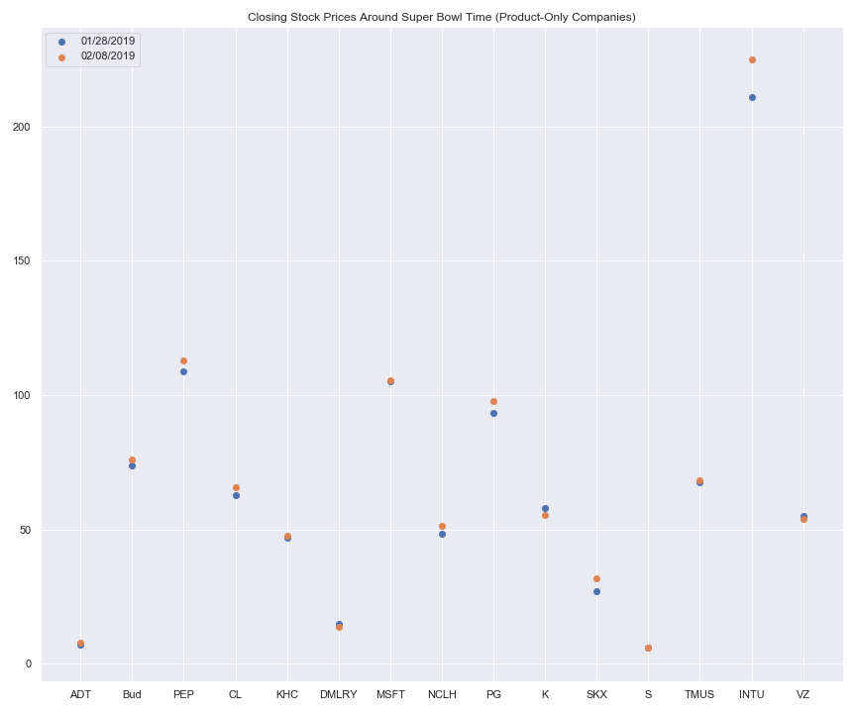
What were the opening prices before Super Bowl LII?
The previous graphs indicated no “positive” affect of the Super Bowl commercial on the stock market. However, looking at the data a little bit closer, we were able to identify a positive trend on the closing price of stocks after the Super Bowl,where most of the examined companies had a price increase.
The referenced graph shows the closing price of all examined companies on 01/28/2019 (a week before Super Bowl) and 02/08/2019 (a week after Super Bowl).

Slide 10
Additional Questions?
Why did it seem that the stocks fell as a whole just before the Super Bowl based on the averages?
What were the impacts on the individual companies?
Which companies showed the greatest increase and decrease?
Is this a trend that occurs every year versus just this year?

Slide 11
Hindsight is 20/20
Looking back, it seems as though this topic is more difficult than it would seem.
Neither API provided consistent stock information for each company. For example, certain companies just wouldn’t have the data available for the specific dates we needed.
Also, the data was not clean. Perhaps if we could’ve taken the time to find a better data set, we wouldn’t have had as many issues.

Slide 12
In Conclusion…
Based on the analyzed data, we feel our results were inconclusive.
In the future, we would expand our scope to include a broader timeframe allowing us to identify other trends in the stock market, such as end of month activity, etc., which would assist us on eliminating “regular” fluctuation and help us better answer our original question.

